Slide 1

Evolution: Sound Recording Devices
Rewind Back Into The Past

Slide 2


Contents
Team Members
Driving Questions- Questions that come upon this topic
Behind The Scenes- Video, Experience
Interactions- Websites, Quizzes, Padlet
Thank You- The End

Slide 3
Group MEMBERS
Anmol Kaur Kalra
Anvi Gupta
Atharv Paliwal
Atiksh Agarwal
Atishay Jain
Devansh Dhar

Slide 4
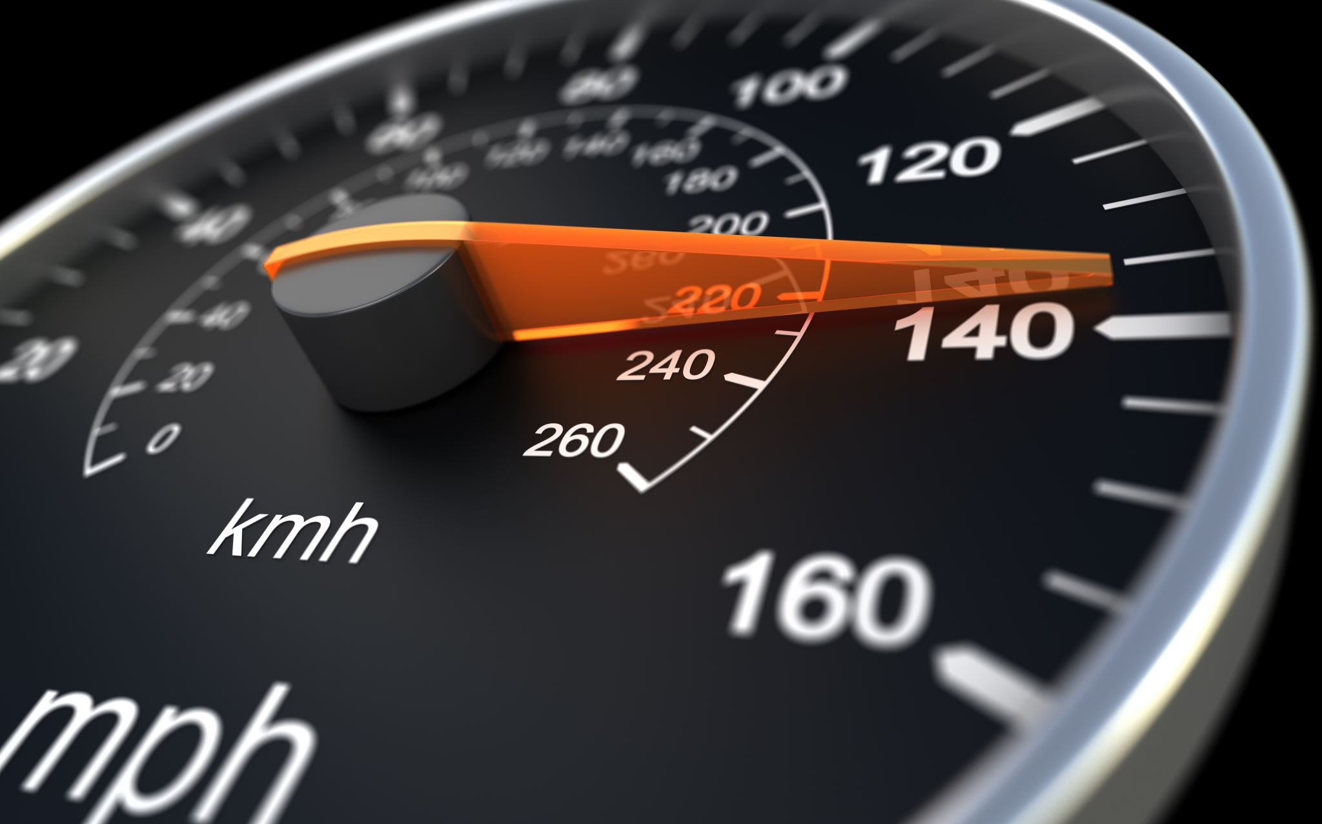
Driving Questions
Questions that drive out from this topic

Slide 5
Find out about any historical facts, important dates or any story that are connected to the device.
Answer by Anmol

Slide 6
Read the biography of the scientist related to the invention.
Answer by Anvi

Slide 7
Early life without these equipment and items?
Answer by Atharv

Slide 8
Effect of the equipment on environment?
Answer by Atiksh

Slide 9
How has the device helped us in early times?
Answer by Atishay

Slide 10
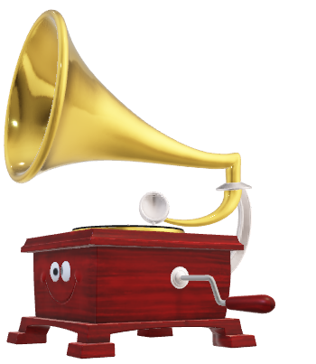
Who was the first inventor of this equipment?
Invented in 1860 the 'Phonautograph' Is Earliest Known Recording Audio historians have found a sound recording that predates Thomas Alva Edison's phonograph by nearly 20 years. The "phonautograph" was patented in 1857 by Edouard-Leon Scott de Martinville; the device recorded images from sounds, tracing squiggles in black soot coating a surface.
Answer by Devansh

Slide 11
How does this invention motivate you?
Hey Parents!
Please click this link for telling how this great invention inspires you!
https://answergarden.ch/1481513
Answer by Devansh

Slide 12
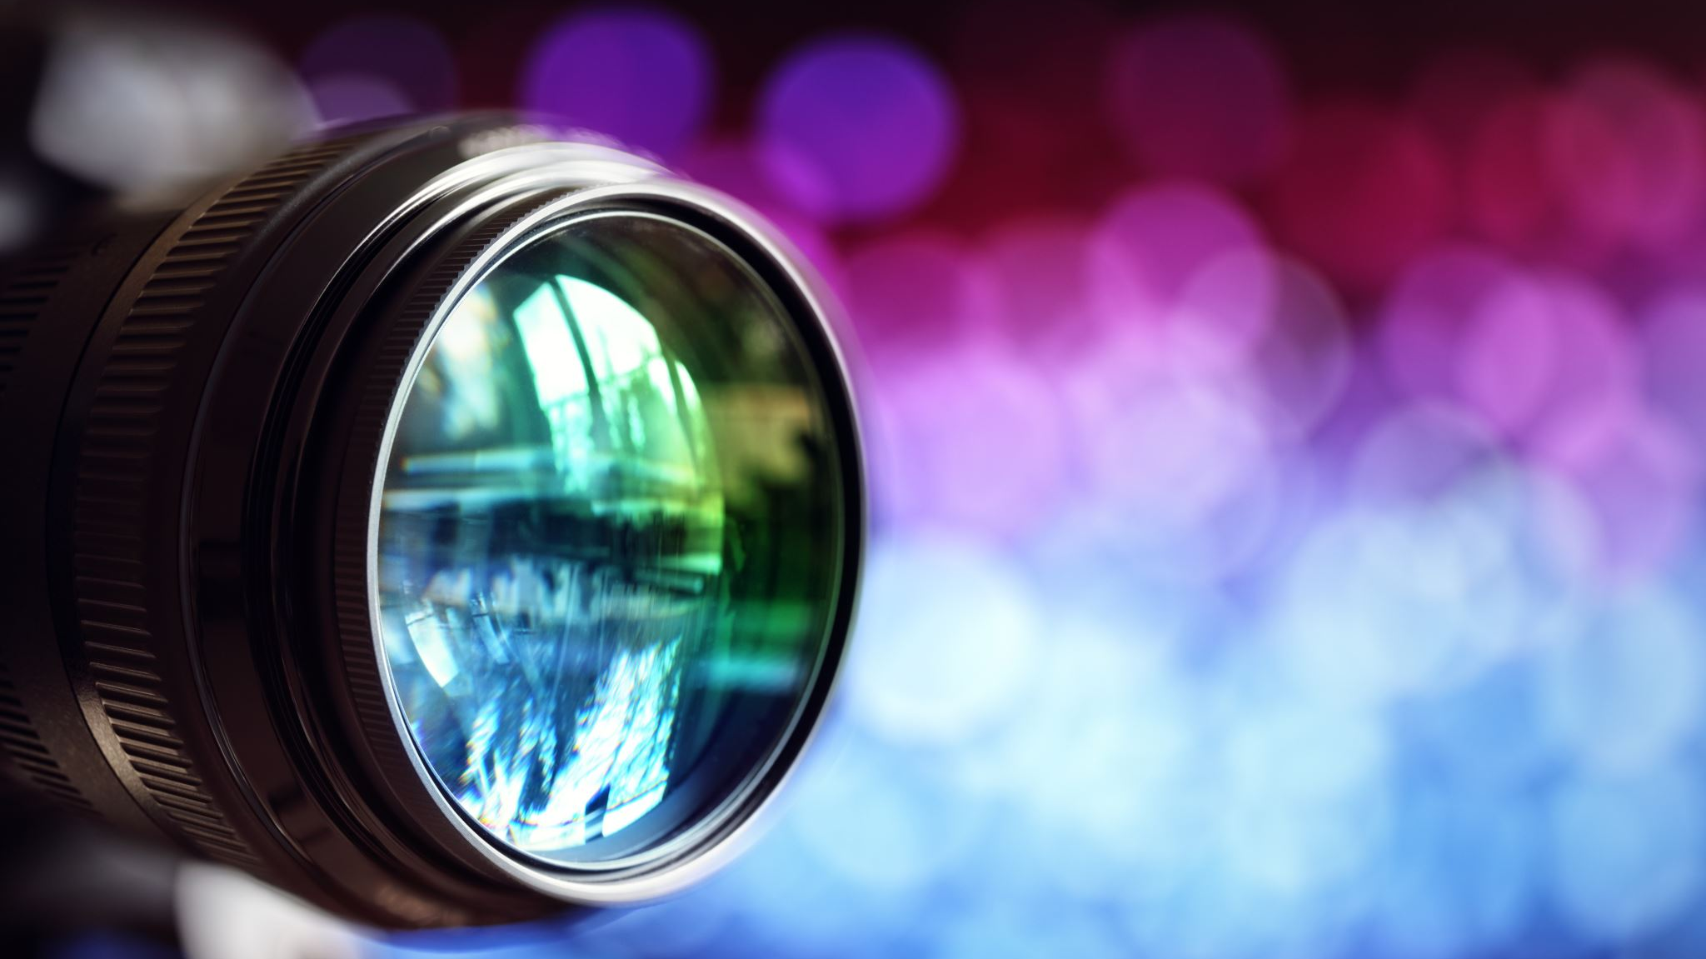
Behind the scenes
Check out how we made it

Slide 13
video

Slide 14

interactions
TO KEEP YOU INTERACTED

Slide 15
Websites That we made
Compiled Website Link:
Separate Website Links:

